Slide 1

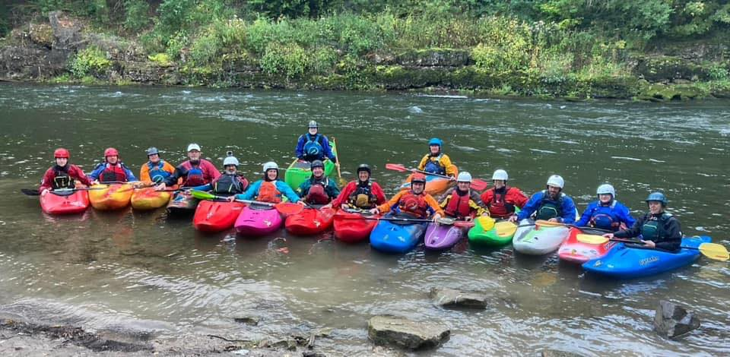

Wombourne Kayak Club AGM 2022
Trysull Village Hall 12th January 2023

Slide 2
Agenda
Wombourne Kayak Club AGM 2022
Introduction
Financial Report
Equipment
Membership
Training completed in 2022
Governance – amendments to the constitution
Trip Planning
Priorities for 2023
Questions?
Thank You!

Slide 3
Wombourne Kayak Club AGM 2022
Welcome to the Wombourne Kayak Club Annual General Meeting 2022.
The Club has had a busy year in several areas. We have welcomed many new members who have enriched the Club with enthusiasm, friendship and a real willingness to contribute to the positive ethos of the Club
Training has been busy, putting 18 members through WWSR and 12 members through 16 hour first –aid courses
We held 30 Jackfield club nights, these were hugely successful with many members attending
We held 19 pool sessions attended by members of all ages and abilities, meaning over 250 hours of practice sessions were completed. Members have learned basic paddling strokes, rolls, T-rescues and capsize drills
We held a beginner’s playboating day at Mile End Mill with the British freestyle champion
2 coaches have completed their discipline-specific Whitewater coaching modules and we have one member working towards a WW SUP coach qualification. These have all been either fully or partly funded by the Club.

Slide 4
Wombourne Kayak Club AGM 2022
3 river leaders were assessed as providers of the British Canoeing Whitewater Award
1 river leader completed Paddle Safer provider training and certification
1 river leader completed the Advanced Whitewater Safety and Rescue certification
1 river leader completed Advanced Whitewater Leader training
The Club completed 2 river clean-ups on the Ironbridge section of the River Severn

Slide 5
Financial Report
Wombourne Kayak Club AGM 2022
The Club finished 2022 with a balance of £2500. This is broadly the same as we started the year with.
Significant financial transactions by the Club in 2022:
The Club was successful in it’s application to BC for a training bursary of £1650- the Club matched this with a £550 contribution
3 boats were purchased at a cost of £1160 (medium Molan, small & medium Mamba, large Machno)
3 boats were sold with an income of £801.79 (medium and large Z One, Approach 9.0)
Pool sessions generated £1172.50, and cost £847.90
Membership generated £685
A full list of all bank transactions for the year is available on request

Slide 6
Equipment
Wombourne Kayak Club AGM 2022
The Club has the following stock of kayaks:
Dagger Mamba 8.6
Dagger Mamba 8.5
Dagger Mamba 8.1
Dagger 7.6
Pyranha Machno large
Pyranha Molan medium
Pyranha 9R
Wavesport Diesel 75
Dagger G Force 6.3
Riot Magnum

Slide 7
Membership
Wombourne Kayak Club AGM 2022
Membership overall has increased from 22 at the beginning of 2022, to 61 at the beginning of 2023
Members at the beginning of 2022 22
Members at the beginning of 2023 61
Female members at the beginning of 2022 3
Female members at the beginning of 2023 10
Whitewater Leaders 5
Whitewater Coaches 2

Slide 8
Training / Compliance Completed in 2022
Wombourne Kayak Club AGM 2022
Whitewater Safety and rescue 18
Advanced Whitewater Safety
and Rescue 1
16 Hour Outdoor First Aid 12
Whitewater Coach Training 2
DBS vetting 5
Paddle Safer Provider 1
Duty To Care certification 1

Slide 9
Governance
Wombourne Kayak Club AGM 2022
Amendments to Constitution.
The following amendments to the Club Constitution are proposed:
Add this statement:
(f) Acceptance: The power of acceptance shall rest with the Club Officers Committee who may, with reasonable cause, refuse to accept to membership any applicant without disclosing their reason for so doing. The Club Officers Committee may at their sole discretion, and with reasonable cause, decline to accept renewal of membership, from any person without disclosing their reason for so doing.
Remove the statement in red, and replace with the statement in green:
(h)Any member may resign giving one month’s clear notice in writing to the secretary. No refund of the subscription fee will be payable.
A member may resign at any time by giving notice to any Committee member in writing (including email, text message, WhatsApp message), but shall not be entitled to a refund of any subscription paid.

Slide 10
Governance
Wombourne Kayak Club AGM 2022
Amendments to Constitution.
The following amendments to the Club Constitution are proposed:
Remove the statement in red, and replace with the statement in green:
An audited statement of annual accounts will be presented by the Club Treasurer at the Annual General Meeting
The accounts will be presented by the treasurer at the Annual General Meeting following the end of the calendar year. This presentation may be either verbally or in written form.
Add the statement in green:
Any cheques drawn against club funds should hold the signatures of the treasurer plus up to two other officers (Rich Dowen, John Teuwen and Paul Elkington are authorised signatories).

Slide 11
Governance
Wombourne Kayak Club AGM 2022
Amendments to Constitution.
The following amendments to the Club Constitution are proposed:
Remove the statement in red:
(b) The Club shall hold the Annual General Meeting (AGM) in the month of January to:
Receive a report from an Independent Auditor (Simon Bink’s brother-in-law TBC) those responsible for certifying the Club’s accounts.

Slide 12
Governance
Wombourne Kayak Club AGM 2022
Amendments to Constitution.
The following amendments to the Club Constitution are proposed:
Add the statements in green
POWERS OF DECISION. Any matter not provided for in this constitution, or any question over the interpretation of it shall be dealt with by the Committee, whose decision shall be final.
ENDORSEMENTS
Wombourne Kayak Club does not endorse any equipment suppliers, equipment manufacturers or canoeing/kayaking coaching businesses. Any related advice from its members is solely their own opinion.

Slide 13
Governance
Wombourne Kayak Club AGM 2022
Amendments to Constitution.
The following amendments to the Club Constitution are proposed:
Add the statements in green
DATA PROTECTION STATEMENT
Personal information given to us on the club’s membership and health declaration forms is solely for the purpose of administration of the club and communicating directly with members. It will be treated in confidence and will not be shared with anyone. Members can request to view their own personal data held by the club by emailing the Membership Secretary at johnteuwen@hotmail.co.uk

Slide 14
Trip Planning
Wombourne Kayak Club AGM 2022
WKC aims to run trips that are interesting, varied, but above all – safe
All club trips must be supervised by an appropriately experienced and qualified leader
BC Whitewater leaders are qualified to lead a group of paddlers on moderate water (grade 2/3), with a recommended ratio of 1:4. This ratio will go up or down depending on conditions, group experience, environment and number of paddlers on the trip
Sometimes a trip will have to be cancelled if levels are higher, or weather worse than expected, or the balance of leaders to paddlers puts the safety of the group at risk
WKC encourages members to work towards their Whitewater leader qualification. This will benefit the individual, and the club, enabling more frequent and varied trips for everyone

Slide 15
Priorities for 2023
Wombourne Kayak Club AGM 2022
The Club’s priorities for 2023:
Continue to provide a safe, inclusive and welcoming environment, where our members feel valued and respected, regardless of race, colour, sex, age, religion, ability or disability, sexual orientation or gender identity
Continue to provide first class training and mentorship to our members
Continue to provide regular trips to interesting venues
Promote our members into positions of leadership and develop them as coaches
Listen to the needs of the members and respond appropriately
Respond vigorously to complaints of bullying, harassment or unfairness

Slide 16
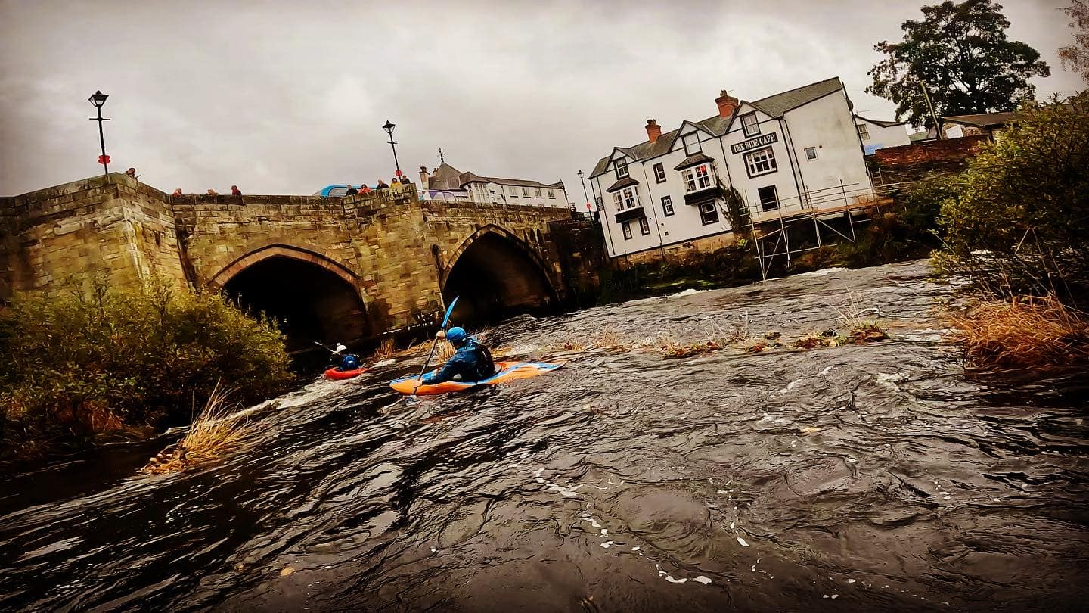
Questions?
Wombourne Kayak Club AGM 2022

Slide 17

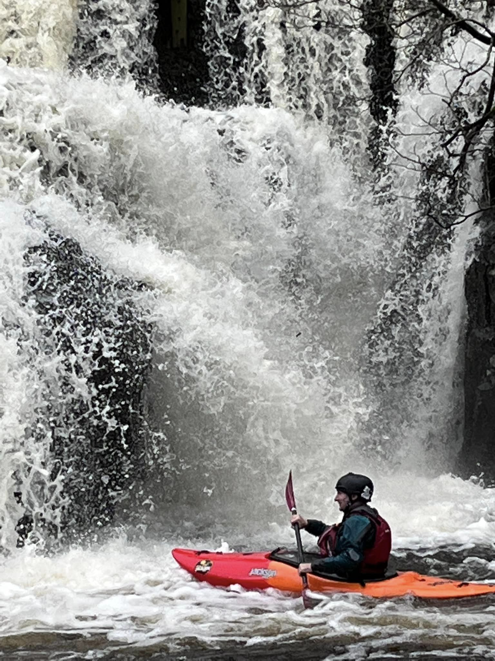
Thank You!
Wombourne Kayak Club AGM 2022

